Slide 1
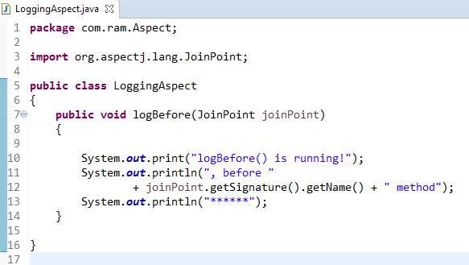
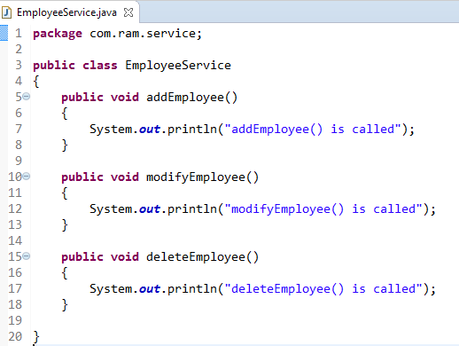
Spring AOP + AspectJ in XML configuration - AspectJ <aop:before> = @Before
@Before declares the before advice. it is executed before the actual method call.
@Before
method
1
2

Slide 2
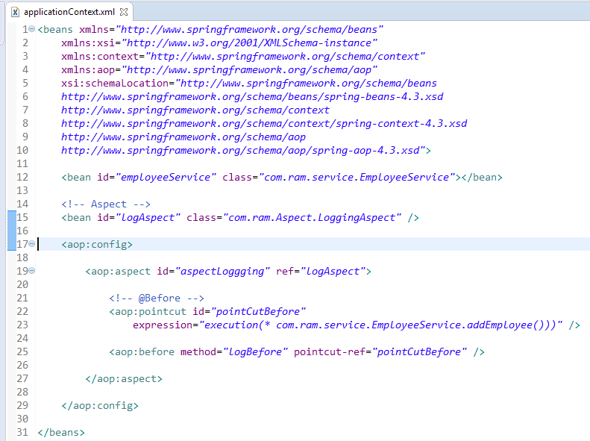
AspectJ <aop:before> = @Before

Slide 3
